Slide 1

Employee data analysis using excel
Student : Harini. C
Register number: 22com830
Department: commerce
College: Valliammal college for women

Slide 2

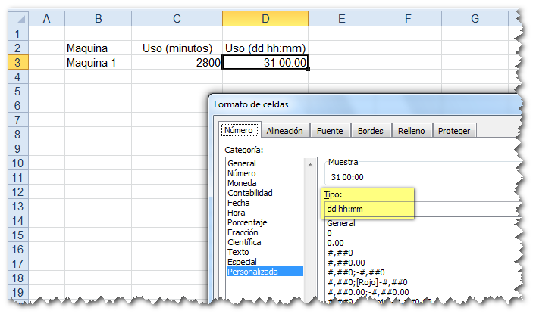
PROJECT TITLE
Employee performance analysis using excel

Slide 3

Agenda
Problem S
Problem Solving
Project Overview
End Users
Our Solution and Proposition
Dataset Description
Modelling Approach
Results and Discussion
conclusion

Slide 4


PROBLEM STATEMENT
Utilize Excel to efficiently analysis employee data leveraging function such as PIVOT TABLES, and conditional formatting.
The enables the identification of key trends, such as current employees rates, performance levels. Decision –making processes by visualization this data through pie chart.

Slide 5



Project overview
This project focuses on analyzing employee data to identify trends and insights that can drive better decision.
Excel will be used to clean, organize, and visualize key metrics such as Employee demographics, performance, and rates. The analysis will highlights areas of improvement in workforce management Helping to optimize resource allocation.
Outcomes will include detailed reports and dashboard for management Review. The finding aim to support strategic planning

Slide 6


WHO ARE THE END USERS
The end users of the employee data employee data analysis are HR Managers team leads and senior management.

Slide 7


OUR SOLUTION AND ITS VALUE PROPOSITION
Conditional formatting – highlights missing cells
Filter – helps to remove the empty cells
Formulas – helps to identify the performance of employees
Pivot table – helps summarize
Pie chart – shows the data

Slide 8

DATASET DESCRIPTION
Employee ID
First name
Gender
Department
Salary
Start date
FTE
Employment type
Work Location

Slide 9

THE “WOW” IN OUR SOLUTION
IFS(Z8>=5,”VERYHIGH”,Z8>=4,”HIGH”, Z8>=3,”MED”,TRUE,”LOW”)

Slide 10

MODELLING
DATA COLLECTION
Identification
Gathering
Preparation
DATA CLEANING
Standardization
Correction
Validation
SUMMARY
Data analysis involves examining, transforming, and modeling data to Extract insights , identify patterns, and support decisions-making.

Slide 11
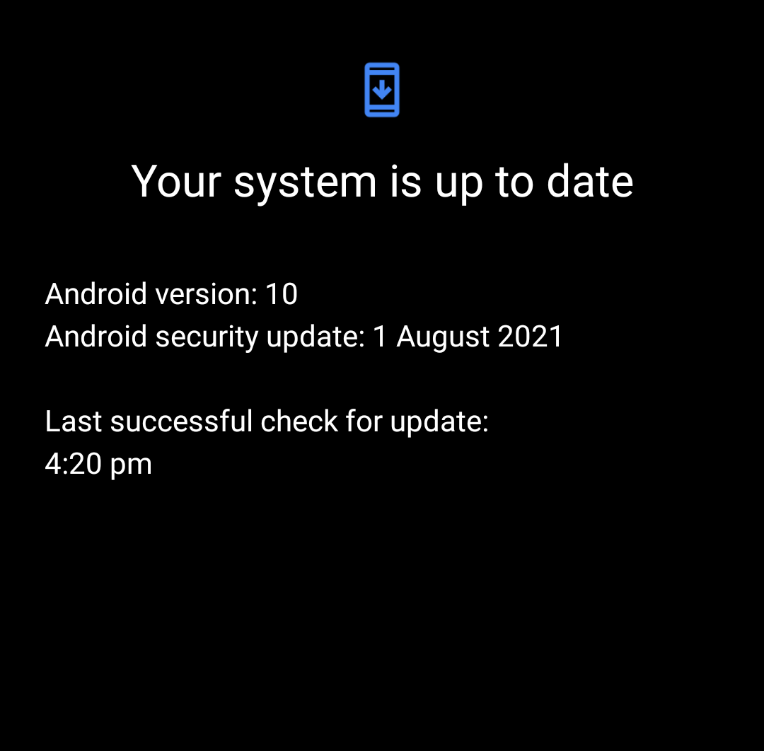
RESULT

Slide 12
CONCLUSION
CONCLUSION
In the employee data analysis conducted using Excel Provided valuable insights into workforce trends enabling more Informed decision-making. The use of Excel allowed efficient data organization, visualization and reporting, ultimately helping to enhance HR strategies, improve and employee satisfaction and optimize overall organizational performance

